Slide 1
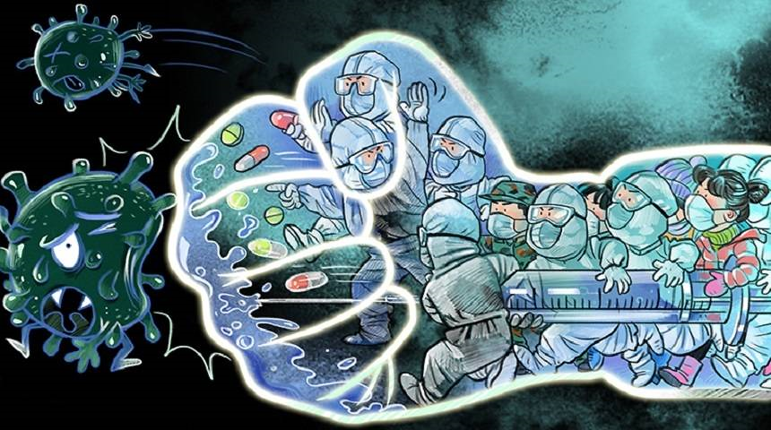
Surveillance and Monitoring System for COVID-19
Presented
By
Corona Fighters

Slide 2
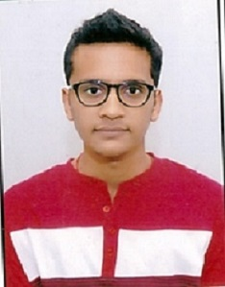
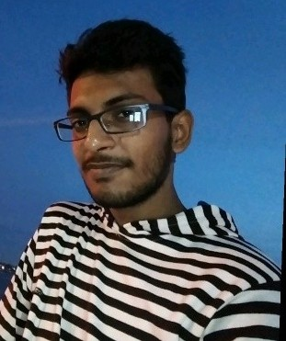
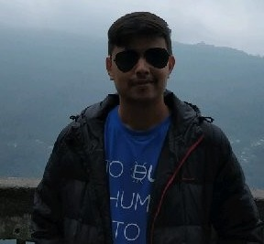
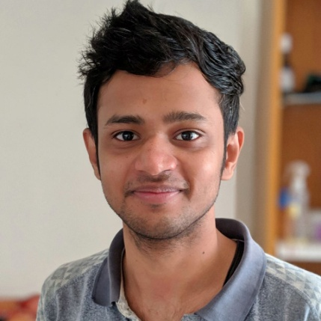
About Team
Aman Jain
Pursuing Mtech from IIT Roorkee.
Research Experience in Computer vision and Artificial Intelligence. Worked with TCS on Model Visualization and Characterization .
We are highly motivated individuals who love to solve problems with technology.
We, as a team have successfully deployed various products most notably MYCOL – a platform for connecting student and professors.
We have also participated in Smart Indian Hackathon conducted by Government of India.
Perfect blend of academic and industry experience.
Exposure from Premier institutes like IITs and experience of working in startups.
Siddharth Gupta
Worked in Ibeyonde as Data Scientist. Experience in areas of Computer vision and Deep Learning. Worked with Indian army on intelligent target detection.
Abhijeet Bhandari
Pursuing Mtech from IIT Kharagpur. Research experience in area of computer vision. Currently working on improving autonomous driving in urban environment.
Abhishek Rajak
Working at IndusFace as Security Engineer. Working in area of cryptography and security analysis.

Slide 3







The Problem
Ramesh is a salesman, he meets on an average 4-5 people in a day
Ramesh gets infected with coronavirus
After 4 days Ramesh shows symptoms and is quarantined
Till 4 days Ramesh has infected 256 patients
Only partial vulnerable carriers (let’s say 128) are tracked and are home quarantined using manual tracing.
Remaining 128 people can still infect 20k people in next 3 days.
1.
Only small proportion - out of all possible infected people can be traced
2.
Not possible to keep check on movement of quarantined people 24x7
3.
Not possible to keep check on people gathering 24x7
Manual tracking and monitoring by police or volunteers become less and less efficient as no of infected people increases.

Slide 4
















Solution
20,000
256
Ramesh is a salesman, he meets on an average 4-5 people in a day
Ramesh gets infected with coronavirus
After 4 days Ramesh shows symptoms
Smart surveillance system sends a real time alert with pictures of Ramesh.
Using AI search Ramesh photo is search across all cameras for past 4 days. In few minutes photos and location of all connections that could be infected is generated.
All possibly 256 infected people are quarantined at there home
Suresh tries to run away from quarantine. Smart surveillance track Suresh and sends real time alert to local police. Suresh is brought back to quarantine
As a result. No of cases drop down to 256 using smart surveillance system
1.
All possible infected people and their location can be traced using face recognition and image search.
2.
Real time alerts 24x7 can be generated as system can continuously monitor quarantined people.
3.
For any location crowd gathering alert can be generated if density of area increases after certain threshold.
Automatic tracking and monitoring by smart survellience system remains efficient even when no of infected people increases.

Slide 5
Methodology
Dataset :-
1. To Test our solution dataset we require dataset with pedestrian crowd in which a few of people is present across multiple CCTV cameras. No open source dataset is present for this scenario.
2. Hence we created our own dataset by combining street view from different cities pre and during lockdown, combining movie trailers having different actors etc.
3. To test the accuracy of system prototype is run on manual dataset and accuracy is measured as per no of times correct alert is generated.
PRE-EXISTING WORK
1. Proposed solution is unique and no pre existing system is currently available.
2. Individual modules like crowd gathering system, people tracking or face recognition are well known research problems, lot of work is done in these areas and is available in open source domain.
3. We have used pre-existing weights of some neural architectures from open source domain as enough data and time is not available to completely train the model.

Slide 6
Methodology
Flow diagram and Model Details
Training model for detecting infected person
ResNet-50
Face Detection
FaceNet
128-dimension embeddings of all detected faces
SVM
Learn unique feature of person
Trained Model
DATA
Infected person images
Model trained for infected person recognitions
1. Possible Infected People search (PIPS)
Trained Model
Social Distance check
Possible Infected People detected
Last Location
Model trained for infected person recognition
CCTV videos
CCTV footages of past 14 days
Check for minimum distance between infected person and unknown person
Save Images of all unknown person who came in close contact with infected person
Show images of all possible infected people with there last location

Slide 7
Methodology
Flow diagram and Model Details
2. Quarantine Person Track
Trained Model
CSRT Tracker
Tracking
Last location
Real Time CCTV videos
Trained Model Continuously analyzing video using model.
CCTV footages from area continuously uploading to cloud
If person is recognized send the co-ordinates to csrt tracker
CSRT tracker starts tracking the person across multiple cameras
Updating last geographic location of person.
3. Crowd Gathering Detection
YOLO V2
Social Distance
Alert
Real Time CCTV videos
CCTV footages from area uploading to cloud
Detecting people in the frame
Using Euclidean distance check for social distancing
Crowd is gathered and social distancing is not maintained generate an alert.

Slide 8
Final Results/Confusion Matrix
All results of system are tested on Manual Dataset.
PIPS | Actual value(as confirmed by experiment)
Predicted Value (predicted by test ) |  | Positive | Negative
 | Positive | 60 | 10
 | Negative | 8 | 22
CGD | Actual value(as confirmed by experiment)
Predicted Value (predicted by test ) |  | Positive | Negative
 | Positive | 57 | 13
 | Negative | 11 | 20
QPT | Actual value(as confirmed by experiment)
Predicted Value (predicted by test ) |  | Positive | Negative
 | Positive | 53 | 10
 | Negative | 12 | 25

Slide 9

FINAL DEMO
In case live demo faces any issues this embedded video can be played

Slide 10








Real World Deployment Model
SMART SURVELLIENCE SYSTEM
Infected People tracing micro server
Sending camera footage via wireless medium
Person monitoring micro server
Master AI Micro server
Police station
CCTV/IP CAMERAS
People counting micro server
Real time alerts
1. Existing CCTV cameras continuously uploading videos to cloud. At cloud AI detections on these videos is performed. If an alert is detected, it is pushed to the web platform provided to nearest police station.
2. Through this web platform police can search all persons who came in contact with infected person. They can put a quarantine person on track, after which they will get real time alert on person’s location.

Slide 11
What’s Next ?
Path to Scale our Solution – 4 Stages
1. Learning : Training our system with data present in specific hotspot areas having multiple CCTV cameras.
2. Initial Deployment : Deploy the system in other areas with CCTV, and improve the robustness of system.
3. CCTV installation initial phase: Start Installing CCTV in places which are already hotspots or where cases are increasing very rapidly. Deploy the system and start searching for carriers in 4-5 days.
4. CCTV installation final phase: In Final phase Install CCTV and deploy the system in remaining places.
How to Scale the solution ?
Outlook behind the classification
1. Effective utilisation of resources.
2. Ensure impact of solution at wider scale.

Slide 12
What’s Next ?
Requirement of additional resources
Stages | GPU | Servers | Storage | CCTV + NETWORK | People
Learning | MEDIUM |  | MEDIUM
Initial Deployment | HIGH | MEDIUM | HIGH |  | LOW
CCTV Initial Phase | HIGH | HIGH | HIGH | MEDIUM | MEDIUM
Final Phase | HIGH | HIGH | HIGH | HIGH | MEDIUM
At each stage we will generate more and more data from feature extractions like face embeddings or images of infected people, hence storage space need to be increased at every stage.
Tracing false positives and negatives at every stage and further retraining the system to adapt those cases will help in improving the accuracy of system, hence resources required for training will increase at every stage.

Slide 13
What’s Next ?
Learning Experience
We have participated in Hackathons before, but this hackathon is very unique as it focuses on very specific problem of COVID 19. Government organization like C-DAC working with top companies like nvidia has provided us with exposure of latest technologies and very useful resources.
It is an excellent opportunity for us, during this time we are learning team coordination and improve communication skills and working while staying in different places.
It helps us to increase our knowledge in depth and come across new concepts and different methods by which we can provide the solution.
We have also learn how responsibility and commitment are essential for success and to learn from our mistakes is the key to the success.

Slide 14
Thank You

